Slide 1
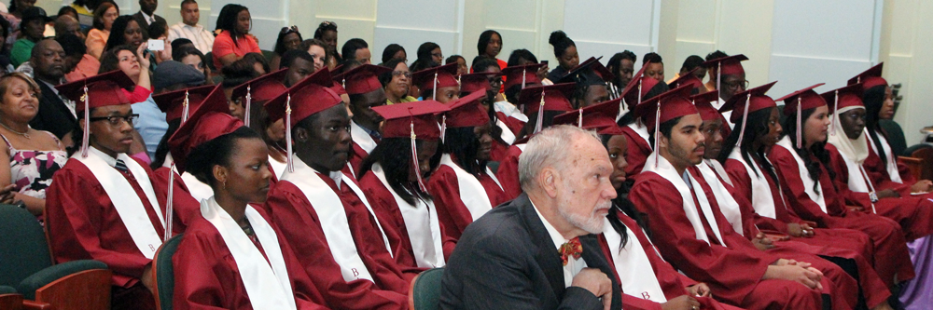
YEAR -1 STUDENT ORIENTATION
2020-2021
BARD HIGH SCHOOL EARLY COLLEGE NEWARK
Building an Intellectual Community

Slide 2
WELCOME TO COLLEGE!!!
What does being a college student mean to you?
BARD HIGH SCHOOL EARLY COLLEGE NEWARK
Building an Intellectual Community

Slide 3
Remote Learning
September 8 - November 17
BARD HIGH SCHOOL EARLY COLLEGE NEWARK
Building an Intellectual Community

Slide 4
Remote Learning ETIQUETTE
Arrive on time
Mute upon Entry
Video On
Appropriate Language
Mutual Respect
Active Participation
BARD HIGH SCHOOL EARLY COLLEGE NEWARK
Building an Intellectual Community

Slide 5
IN-PERSON INGRESS PROCEDURES
TEMPERATURE CHECK (<100.4°)& SYMPTOMS CHECK BEFORE LEAVING HOME
COLLEGE STUDENTS LINE UP AT CAMDEN ST & 16th AVE DOOR TOWARD LOADING DOCK BY 8:15 AM (No Tardiness)
MUST WEAR MASK & SOCIAL DISTANCE
SYMPTOMS CHECK QUESTIONS
TEMPERATURE CHECK (<100.4°F)
FOOTWEAR SANITIZING (Closed toe shoes required -- no sandals/slides)
HAND SANITIZING
FOLLOW DIRECTIONS OF SIGNS AND HALL MONITORS
BARD HIGH SCHOOL EARLY COLLEGE NEWARK
Building an Intellectual Community
Notes:
If temperature is too high, student will wait with a staff member OUTSIDE while parent is called and student gets picked up. Parents must wear masks. No visitors allowed in building. If student gets sick in school, taken to isolation room where student is evaluated by nurse.

Slide 6
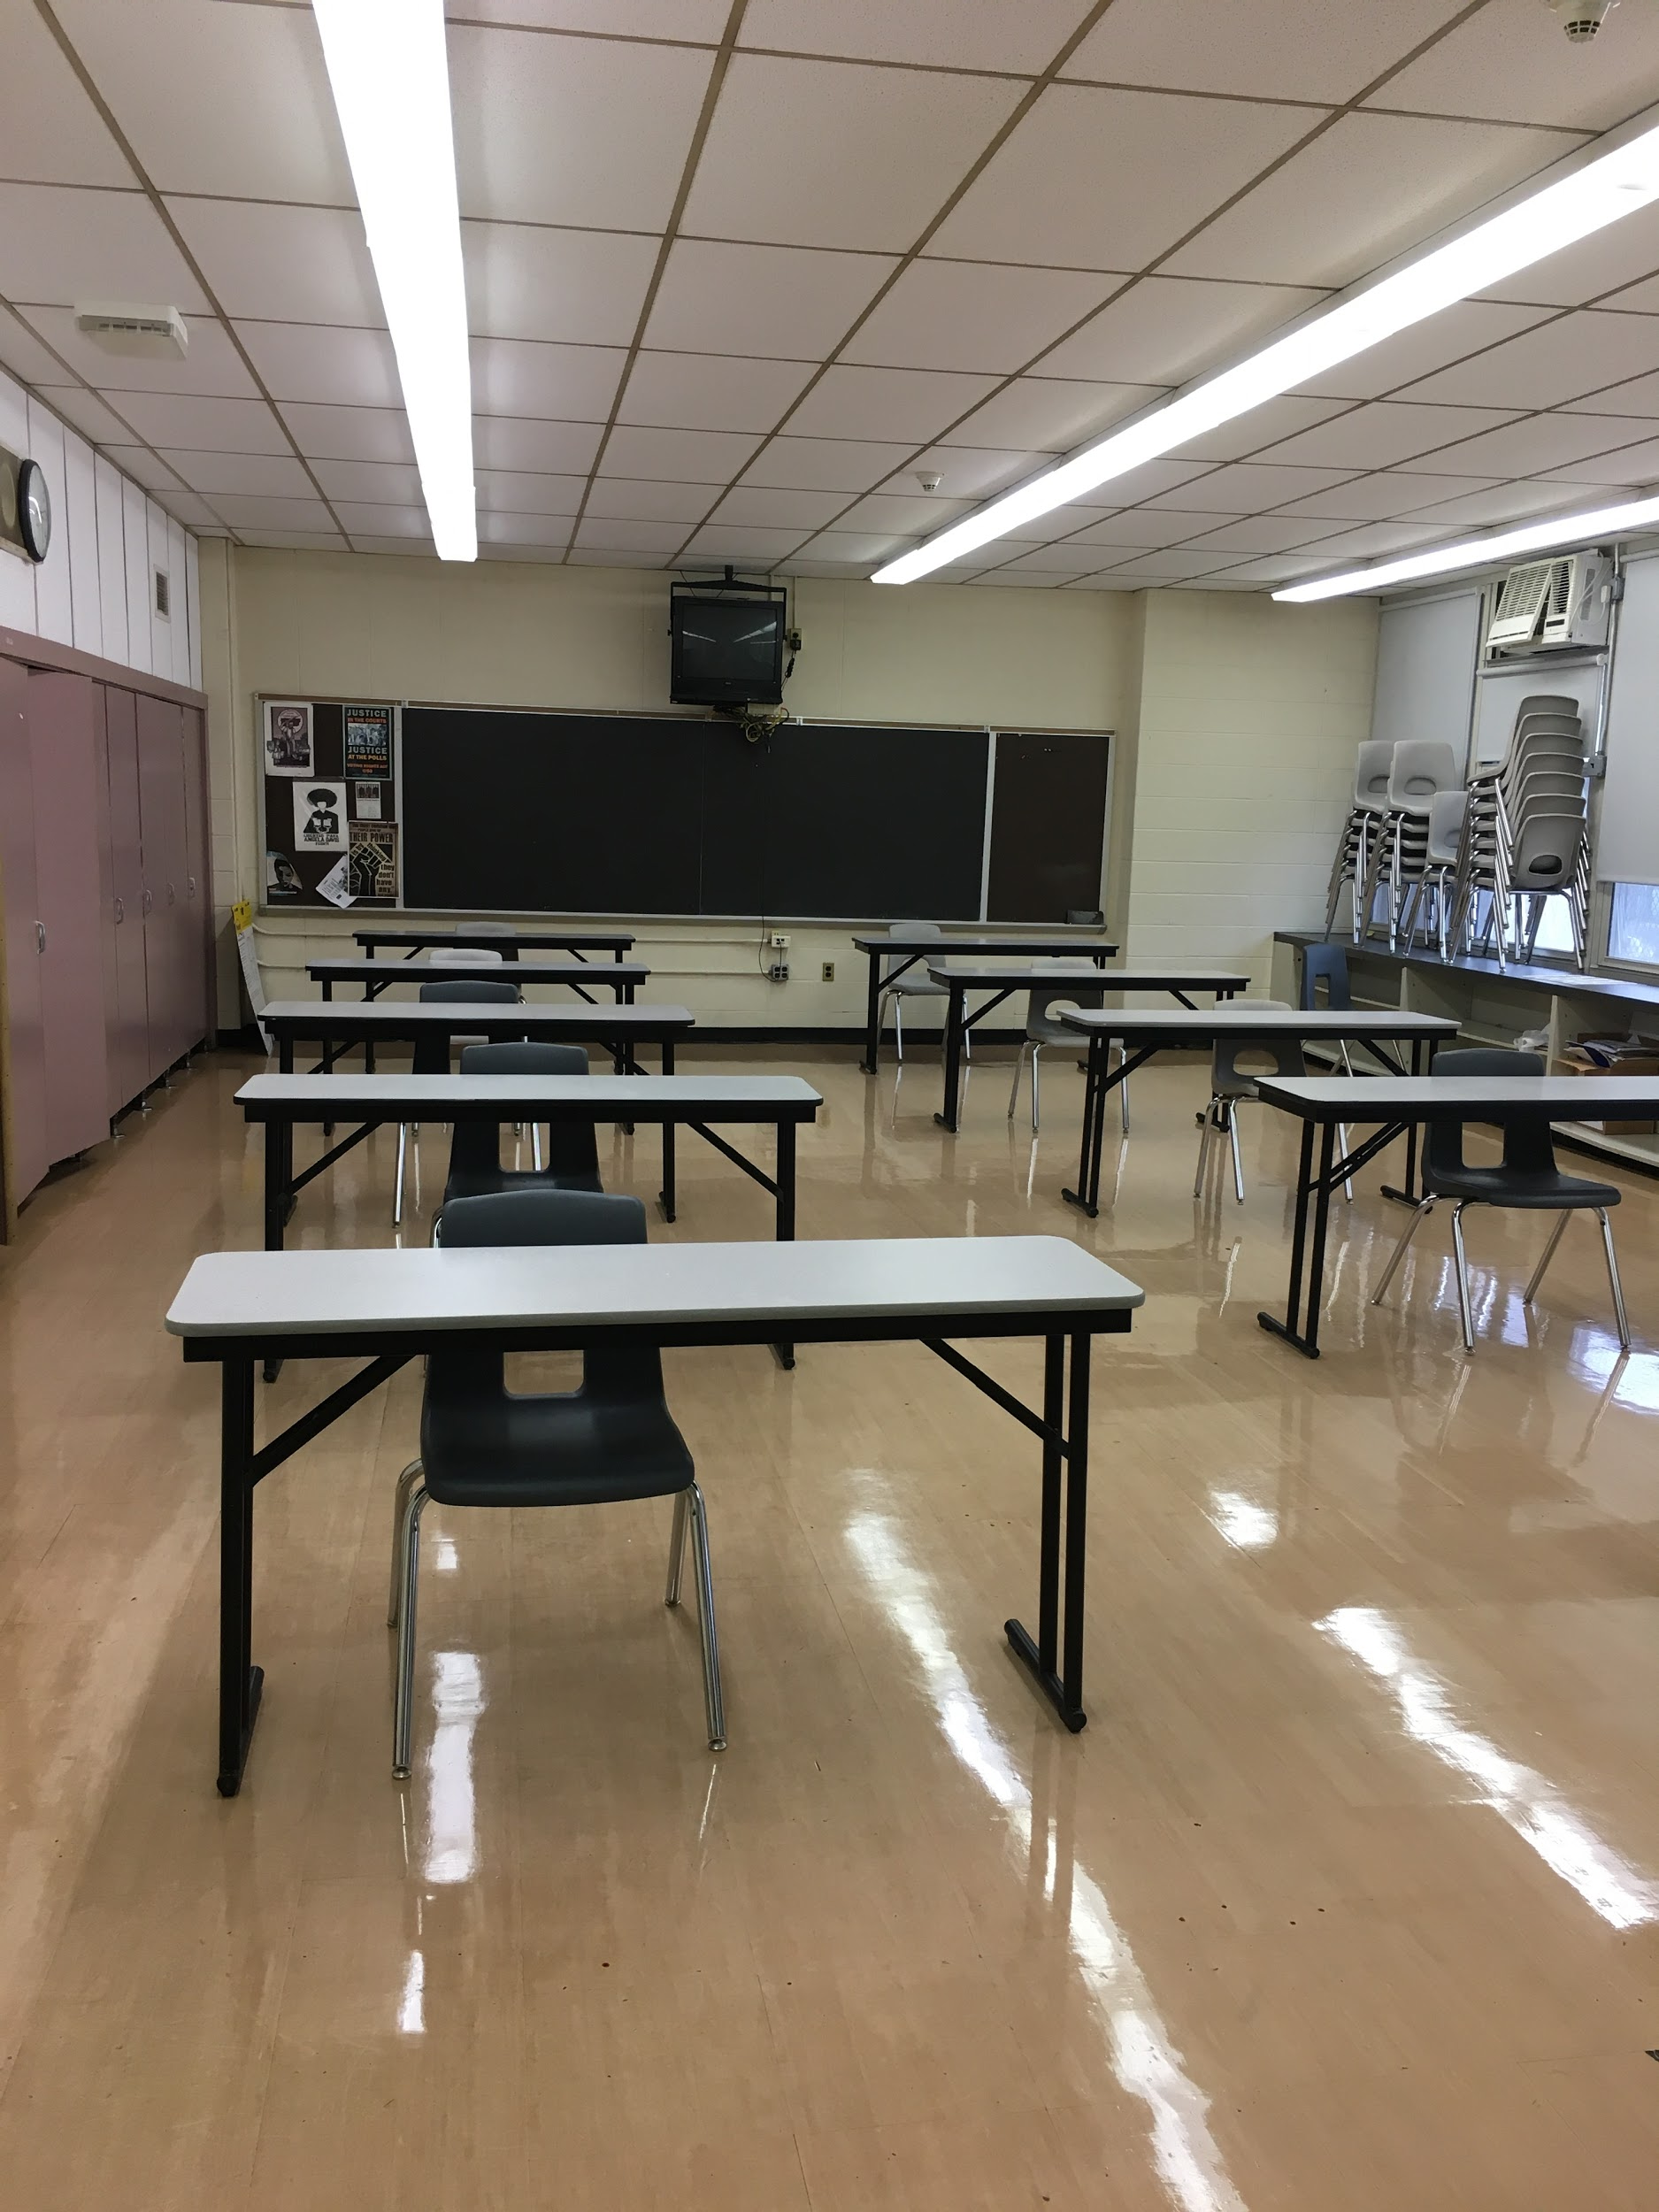
IN-PERSON HEALTH & SAFETY PROTOCOLS
ONLY 10 STUDENTS PER CLASSROOM
6 FOOT SOCIAL DISTANCING
EACH DESK WILL HAVE 3-SIDED CLEAR PLASTIC PROTECTOR
BREAKFAST & LUNCH IN CLASSROOMS (COLD LUNCH FROM HOME IN CLOSED CONTAINERS -- NO DELIVERIES, NO MICROWAVE, NO SHARING)
MUST BRING WATER BOTTLES (NAME OR OTHER ID MARKING)

Slide 7
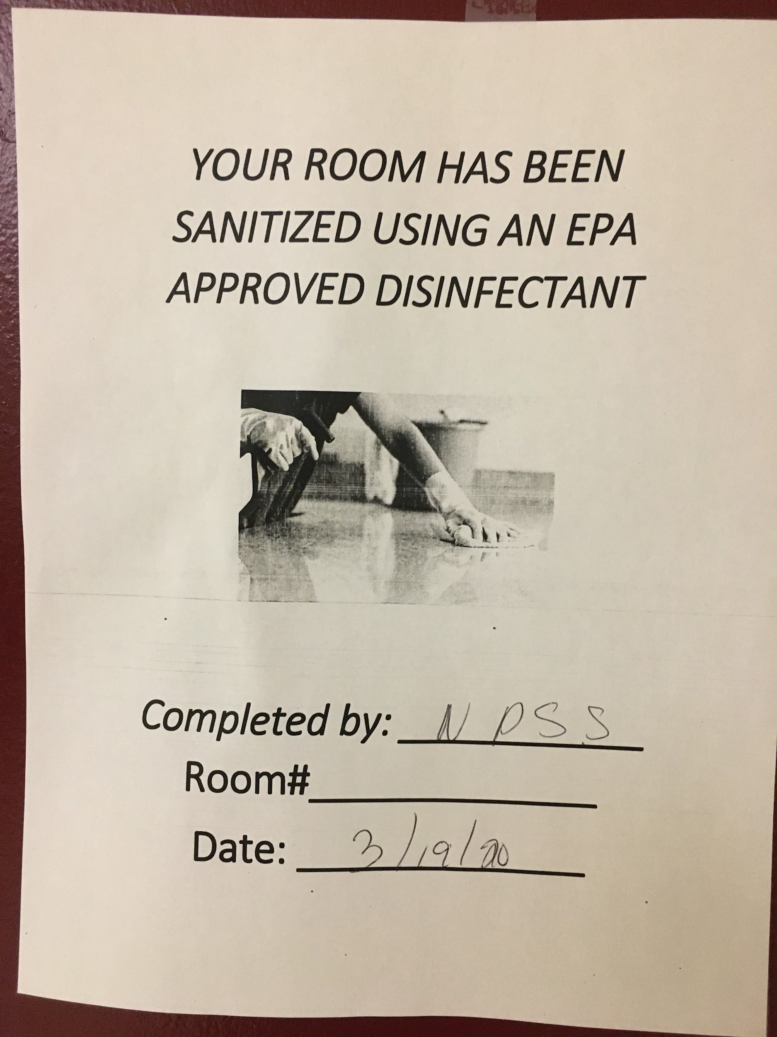
IN-PERSON HEALTH & SAFETY PROTOCOLS
EACH ROOM WILL HAVE SANITIZING KIT (STUDENTS WILL SUPPORT WITH DISINFECTING DESKS & CHAIRS)
CUSTODIAL DETAILS SCHEDULED TO DISINFECT HIGH-TOUCH AREAS DAILY
ROOMS SANITIZED EACH DAY WITH DISINFECTANT MISTING EQUIPMENT
CUSTODIAL SUPERVISOR & PRINCIPAL CONFIRM DISINFECTED DAILY

Slide 8
Bell Schedule
HR | 1 | 2 | 3 | 4 | 5 | 6 | 7 | 8 | 9 | 10
8:15 - 8:22 | 8:24- 9:04 | 9:06- 9:46 | 9:48 - 10:28 | 10:30 - 11:10 | 11:12 - 11:52 Lunch | 11:54 - 12:34 | 12:36 - 1:16 | 1:18 - 1:58 | 2:00 - 2:40 | 2:42 - 3:22
BARD HIGH SCHOOL EARLY COLLEGE NEWARK
Building an Intellectual Community

Slide 9
BHSEC - Newark NEW FACULTY/STAFF, 2020-2021
MR. JAYME ALVES-FILHO (PE/HEALTH)
MR. PHILIPPE ARMAND (MATHEMATICS)
DR. ANAND MHATRE (BIOLOGY)
DR. JAYA SRINIVASAN (CHEMISTRY)
BARD HIGH SCHOOL EARLY COLLEGE NEWARK
Building an Intellectual Community

Slide 10
BHSEC - Newark ATTENDANCE POLICY
100% ATTENDANCE
EVERY DAY MATTERS!
BARD HIGH SCHOOL EARLY COLLEGE NEWARK
Building an Intellectual Community
Notes:
You must attend all classes and arrive on time! Teachers will be taking attendance through PowerSchool.

Slide 11
Q1 SY20-21 GRADING
EVERY GRADE MATTERS!
SEEK SUPPORT EARLY AND OFTEN IF YOU NEED IT!
BARD HIGH SCHOOL EARLY COLLEGE NEWARK
Building an Intellectual Community
Notes:
After school closing, faculty and staff were generous and relied on Q1 performance to help support waning grades. Start strong and focus well. This is not only your senior year in high school, but also your sophomore year in college. You want as many transferrable credits as possible whether you are earning an AA degree or not. -- Transition to Dean of Students - Shaviece Osborne

Slide 12
BHSEC - Newark
ELECTIVES EXPLANATION
AA DEGREE GRADUATION TRACKER
BARD HIGH SCHOOL EARLY COLLEGE NEWARK
Building an Intellectual Community

Slide 13
BHSEC - Newark
Y2 Google Classroom code: 3j6zzvk
Y1 Google Classroom code:6gxd6xm
(Communications and important announcements for Y2 students)
Current assignments posted:AA tracker completion based on your transcript due date: September 1, 2020. Google survey - Due on August 28, 2020
BARD HIGH SCHOOL EARLY COLLEGE NEWARK
Building an Intellectual Community

Slide 14
Name that College Elective
PowerSchool Title | Course | Teacher
College Environmental Science | MicroBiology for Health Sciences | Jayaprakash
College Environmental Science | Bioethics | Agapito
College Environmental Science | Medical Genetics | Mhatre
College Topics in Math II | Topics in Modern Physics | Berman
College Topics in Math II | Computer Science | Griffel
College History of East Asia | Women and Gender in Indian Lit | Marcille
College Topics in Literature | Composition and Writing | Woo
College Topics in Social Sciences | History of Technology | Halvorson
BARD HIGH SCHOOL EARLY COLLEGE NEWARK
Building an Intellectual Community

Slide 15
Requirements for AA Degree
https://docs.google.com/spreadsheets/d/196NMF_FYXj6Etbw-A38JfXx5hH6x9Ct5eizOZdiepHs/edit
1) 4 semesters of college seminar
2) 2 semesters of college math
3) 2 semesters of college lab sciences (if you take bio as a HS course, you will still need to take another college-level lab science course)
4) 2 semesters of college foreign language
5) 2 semesters of College Experience
6) 2 semesters of college humanities and/or social science courses
7) 1 semester of college arts
8) any additional courses necessary to bring our total number of credits to 60
9) Maintain a college GPA of 2.0 or higher
10) 80 hours of community service
11) four years of Writing and Thinking (taken at the beginning of each school year)
BARD HIGH SCHOOL EARLY COLLEGE NEWARK
Building an Intellectual Community

Slide 16
BARD Instructional format guidelines
https://drive.google.com/drive/u/0/folders/1OezcrKvzhInHl-9kpatCtDzPTF8QP8Ps
Bard recommends the following seat time requirements for 18 week semester
.
Number of credits | Instructional time per week | Outside course work per week | Type of instruction
Three | 150 minutes | 300 minutes | Traditional
Three | 75 minutes | 375 minutes | Blended/Hybrid
(Our school current schedule for 3 credit classes) | 200 minutes | 250 minutes | Traditional/ Fully Online
BARD HIGH SCHOOL EARLY COLLEGE NEWARK
Building an Intellectual Community

Slide 17
Requirements for HS Diploma
https://docs.google.com/spreadsheets/d/196NMF_FYXj6Etbw-A38JfXx5hH6x9Ct5eizOZdiepHs/edit
1) College Financial Literacy
2) 4 years of English, Social Sciences, Mathematics and Science
3) 2 years of World language
4) 1 year of Visual and performing Arts
5) 4 years of Health, Safety and Physical Education
6) 1 year of Career and Technical Education
7) 1 year of Electives and a total of at least 130 credits at the end of senior year.
8) 80 hours of community service
9) Passing scores in both ELA and Math Assessment taken in High school (NJSLA; SAT; PSAT;ACT)
10) Senior Thesis
11) Completion of FAFSA application is a new requirement for students this year
BARD HIGH SCHOOL EARLY COLLEGE NEWARK
Building an Intellectual Community

Slide 18
BHSEC - Newark UPCOMING ASSESSMENT DATES
SUMMER READING ASSESSMENT (9/14-9/18)
(Go to NBOE website to access Summer Reading and activities through CLEVER)
ELA, MATH, & SCIENCE MAP ASSESSMENTS (10/1-10/8)
BARD HIGH SCHOOL EARLY COLLEGE NEWARK
Building an Intellectual Community

Slide 19
BHSEC - Newark UPCOMING DISTRIBUTION DATES
FRIDAY, AUGUST 28 - 9:00 AM - 12:00 PM
BARD HIGH SCHOOL EARLY COLLEGE NEWARK
Building an Intellectual Community

Slide 20
BHSEC - Newark
QUESTIONS AND FEEDBACK
BARD HIGH SCHOOL EARLY COLLEGE NEWARK
Building an Intellectual Community

