Slide 1
10th & 9th GRADE
STUDENT ORIENTATION
2020-2021
BARD HIGH SCHOOL EARLY COLLEGE NEWARK
Building an Intellectual Community

Slide 2
Remote Learning
September 8 - November 17
BARD HIGH SCHOOL EARLY COLLEGE NEWARK
Building an Intellectual Community

Slide 3
Remote Learning ETIQUETTE
Arrive on time
Mute upon Entry
Video On
Appropriate Language
Mutual Respect
Active Participation
BARD HIGH SCHOOL EARLY COLLEGE NEWARK
Building an Intellectual Community

Slide 4
IN-PERSON INGRESS PROCEDURES
TEMPERATURE CHECK (<100.4°)& SYMPTOMS CHECK BEFORE LEAVING HOME
9th GRADE LINE UP ON BERGEN ST (MAIN DOOR) 10TH GRADE LINE UP ON 16th AVE BY 8:15 AM (No Tardiness)
MUST WEAR MASK & SOCIAL DISTANCE
SYMPTOMS CHECK QUESTIONS
TEMPERATURE CHECK (<100.4°F)
FOOTWEAR SANITIZING (Closed toe shoes required -- no sandals/slides)
HAND SANITIZING
FOLLOW DIRECTIONS OF SIGNS AND HALL MONITORS
BARD HIGH SCHOOL EARLY COLLEGE NEWARK
Building an Intellectual Community
Notes:
If temperature is too high, student will wait with a staff member OUTSIDE while parent is called and student gets picked up. Parents must wear masks. No visitors allowed in building. If student gets sick in school, taken to isolation room where student is evaluated by nurse.

Slide 5
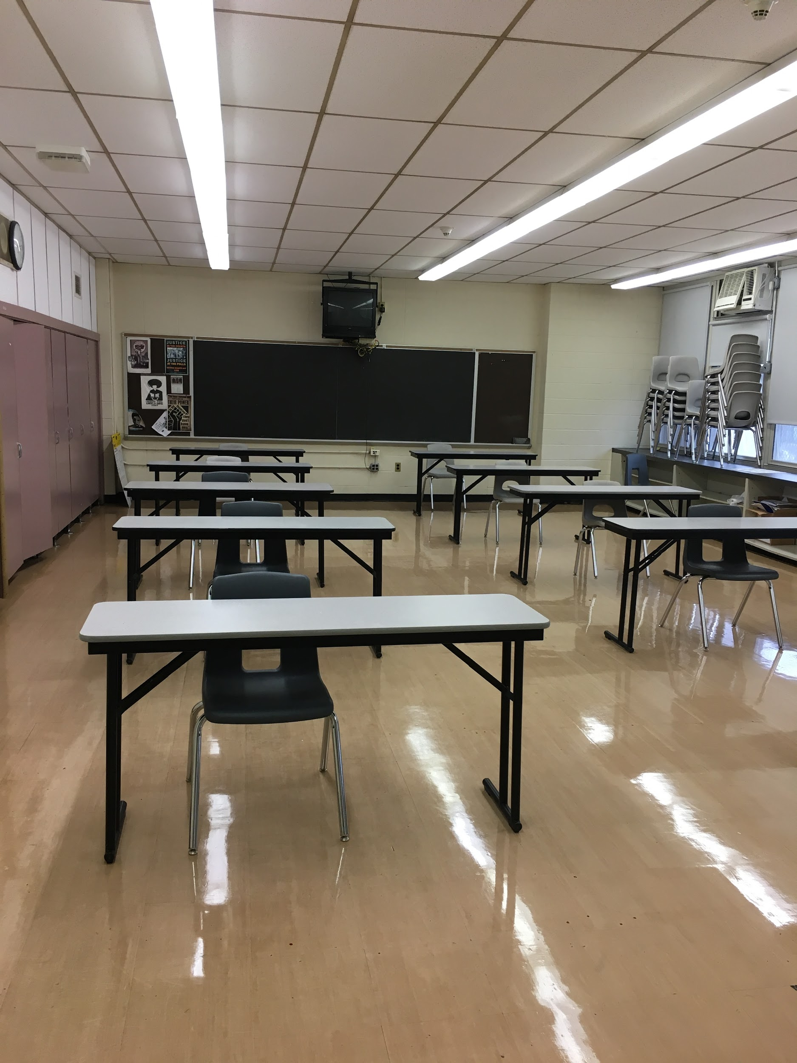
IN-PERSON HEALTH & SAFETY PROTOCOLS
ONLY 10 STUDENTS PER CLASSROOM
6 FOOT SOCIAL DISTANCING
EACH DESK WILL HAVE 3-SIDED CLEAR PLASTIC PROTECTOR
BREAKFAST & LUNCH IN CLASSROOMS (COLD LUNCH FROM HOME IN CLOSED CONTAINERS -- NO DELIVERIES, NO MICROWAVE, NO SHARING)
MUST BRING WATER BOTTLES (NAME OR OTHER ID MARKING)

Slide 6
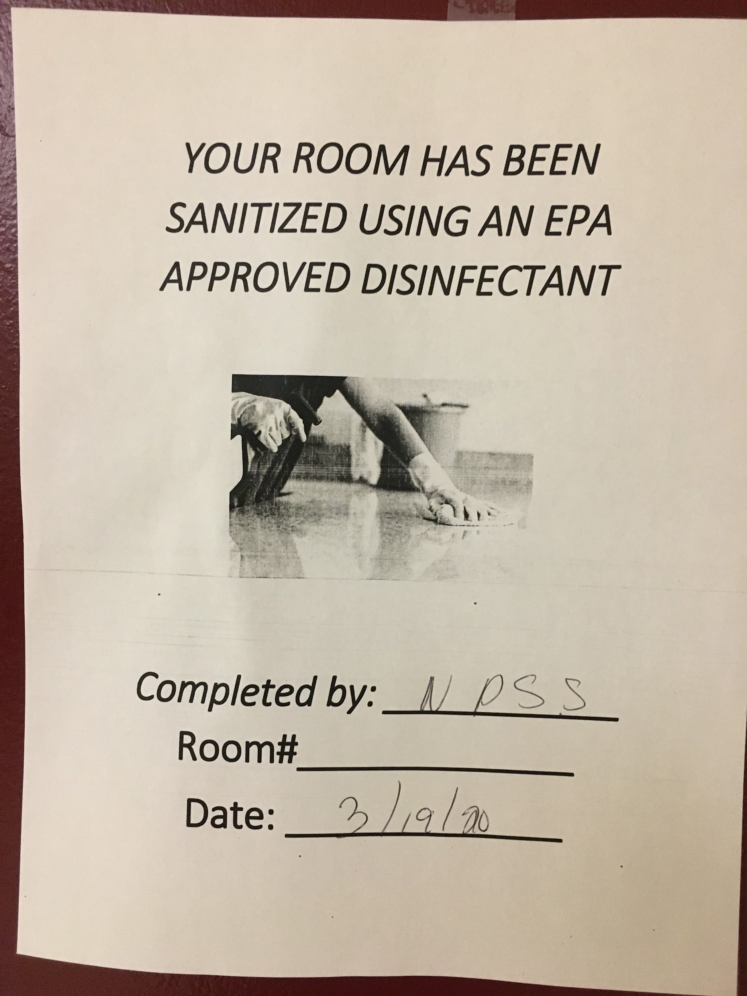
IN-PERSON HEALTH & SAFETY PROTOCOLS
EACH ROOM WILL HAVE SANITIZING KIT (STUDENTS WILL SUPPORT WITH DISINFECTING DESKS & CHAIRS)
CUSTODIAL DETAILS SCHEDULED TO DISINFECT HIGH-TOUCH AREAS DAILY
ROOMS SANITIZED EACH DAY WITH DISINFECTANT MISTING EQUIPMENT
CUSTODIAL SUPERVISOR & PRINCIPAL CONFIRM DISINFECTED DAILY

Slide 7
Bell Schedule
HR | 1 | 2 | 3 | 4 | 5 | 6 | 7 | 8 | 9 | 10
8:15 - 8:22 | 8:24- 9:04 | 9:06- 9:46 | 9:48 - 10:28 | 10:30 - 11:10 Lunch | 11:12 - 11:52 | 11:54 - 12:34 | 12:36 - 1:16 | 1:18 - 1:58 | 2:00 - 2:40 | 2:42 - 3:22
BARD HIGH SCHOOL EARLY COLLEGE NEWARK
Building an Intellectual Community

Slide 8
BHSEC - Newark NEW FACULTY/STAFF, 2020-2021
MR. JAYME ALVES-FILHO (PE/HEALTH)
MR. PHILIPPE ARMAND (MATHEMATICS)
DR. ANAND MHATRE (BIOLOGY)
DR. JAYA SRINIVASAN (CHEMISTRY)
BARD HIGH SCHOOL EARLY COLLEGE NEWARK
Building an Intellectual Community

Slide 9
BHSEC - Newark ATTENDANCE POLICY
100% ATTENDANCE
EVERY DAY MATTERS!
BARD HIGH SCHOOL EARLY COLLEGE NEWARK
Building an Intellectual Community
Notes:
You must attend all classes and arrive on time! Teachers will be taking attendance through PowerSchool.

Slide 10
Q1 SY20-21 GRADING
EVERY GRADE MATTERS!
SEEK SUPPORT EARLY AND OFTEN IF YOU NEED IT!
BARD HIGH SCHOOL EARLY COLLEGE NEWARK
Building an Intellectual Community
Notes:
After school closing, faculty and staff were generous and relied on Q1 performance to help support waning grades. Start strong and focus well. . -- Transition to Dean of Students - Shaviece Osborne

Slide 11
BHSEC - Newark
Grade 10 Google Classroom code:uaycimf
Grade 9 Google Classroom code:z54bn2q
(Communications and important announcements for students)
Current assignments posted:
Google survey - Due on August 31, 2020
BARD HIGH SCHOOL EARLY COLLEGE NEWARK
Building an Intellectual Community

Slide 12
BHSEC - Newark
Any questions on schedules, can be addressed to me via email
mjayaprakash@bhsec.bard.edu
BARD HIGH SCHOOL EARLY COLLEGE NEWARK
Building an Intellectual Community

Slide 13
Requirements for HS Diploma
1) College Financial Literacy
2) 4 years of English, Social Sciences, Mathematics and Science
3) 2 years of World language
4) 1 year of Visual and performing Arts
5) 4 years of Health, Safety and Physical Education
6) 1 year of Career and Technical Education
7) 1 year of Electives and a total of at least 130 credits at the end of senior year.
8) 80 hours of community service
9) Passing scores in both ELA and Math Assessment taken in High school (NJSLA; SAT; PSAT;ACT)
10) Senior Thesis
11) Completion of FAFSA application is a new requirement for students this year
BARD HIGH SCHOOL EARLY COLLEGE NEWARK
Building an Intellectual Community

Slide 14
BHSEC - Newark UPCOMING ASSESSMENT DATES
SUMMER READING ASSESSMENT (9/14-9/18)
(Go to NBOE website to access Summer Reading and activities through CLEVER)
ELA, MATH, & SCIENCE MAP ASSESSMENTS (10/1-10/8)
BARD HIGH SCHOOL EARLY COLLEGE NEWARK
Building an Intellectual Community

Slide 15
BHSEC - Newark UPCOMING DISTRIBUTION DATES
FRIDAY, AUGUST 28 -- 9:00 AM - 12:00 PM
BARD HIGH SCHOOL EARLY COLLEGE NEWARK
Building an Intellectual Community

Slide 16
BHSEC - Newark SUPPORT STAFF
MS. FOSTER, SCHOOL COUNSELOR (FFOSTER@BHSEC.BARD.EDU)
MS. HAMILTON, SOCIAL WORKER (DHAMILTON@BHSEC.BARD.EDU)
MS. MITCHELL, SOCIAL WORKER (TMITCHELL@BHSEC.BARD.EDU)
BARD HIGH SCHOOL EARLY COLLEGE NEWARK
Building an Intellectual Community

Slide 17
BHSEC - Newark
QUESTIONS AND FEEDBACK
BARD HIGH SCHOOL EARLY COLLEGE NEWARK
Building an Intellectual Community

